Slide 1
Future of Emission Test
in Germany
Harald Hahn
Head of working group emission and diagnostic
22. November 2016
Bruessels

Slide 2
Emission test Germany
What is planned at this moment?
We have reached it!
Ministry of transport (BMVI) got the official order from the minister of tranport (Mr. Dobrindt) to re-install the tailpipe test on all vehicles as soon as possible
A Directive is already existing as draft – end of October it was planned to circulate this draft
Ministry of economic (BMWI) and environment (UBA) got this Directive already to make amendments
Some things are under discussion, especially the situation with reference values

Slide 3
Emission test Germany
What is planned at this moment??
Test procedure will be the same we use for vehicles before 01.01.2006 (complete tailpipe test using also information from OBD)
The new procedure will be named Leitfaden 5 Version 01 (not Leitfaden 6) to demonstrate, that the changes are only minor Reference values:
In the directive for Petrol vehicles we propose 0,1 % vol.
For Diesel vehicles we propose at least 0,2 m-1, compromise was fixed to 0,3 m-1, but there is a big discussion
It seems that this is one of the reasons for the delay

Slide 4
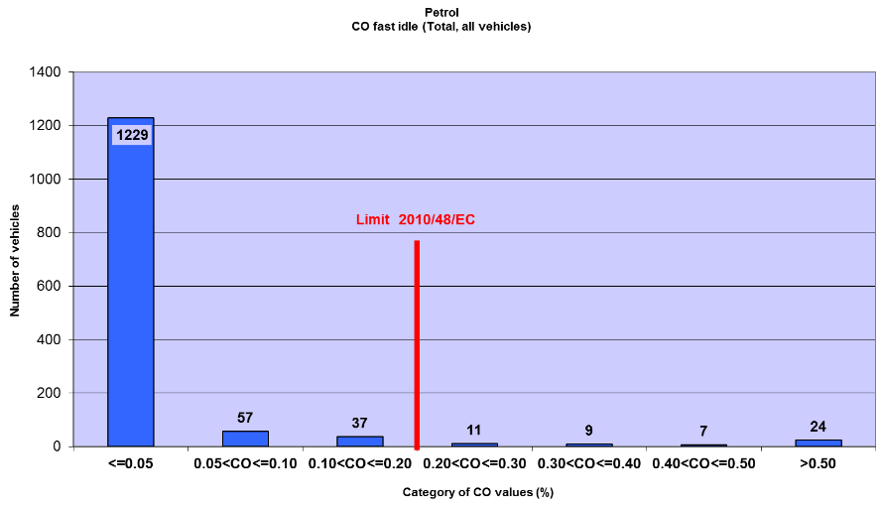
Emission test Germany
Grenzwerte beim Benziner
Quelle: SET Studie

Slide 5
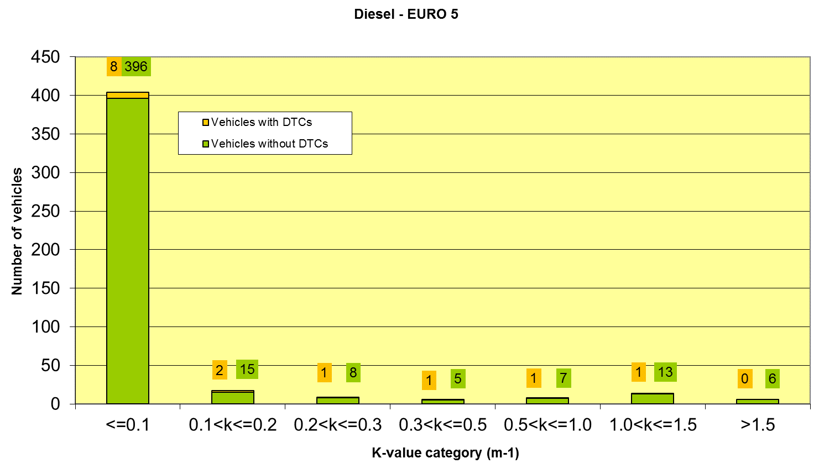
Emission test Germany
Grenzwerte beim Diesel
Quelle: SET Studie

Slide 6
Emission test Germany
Genauigkeit von Opazimetern im unteren Bereich

Slide 7
Danke, dass Sie zugehört haben
Pressegespräch 2016

